Slide 1
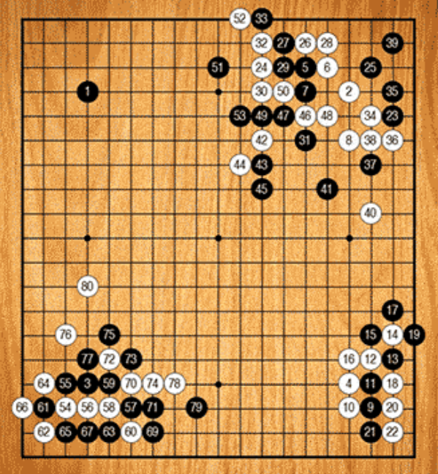
Reinforcement- -learning
Go

Slide 2
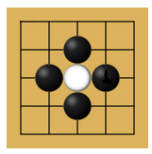
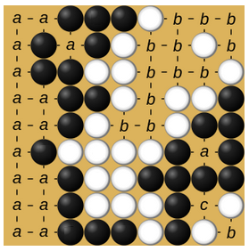
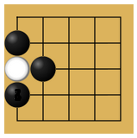
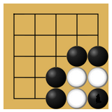
The game Go - Rules
19x19 Board
Passing is allowed
Stones are captured if all adjacent intersections are occupied by the enemy
It is not allowed to recreate former state of the board
Game ends after two consecutive passes
Player with larger controlled area wins

Slide 3
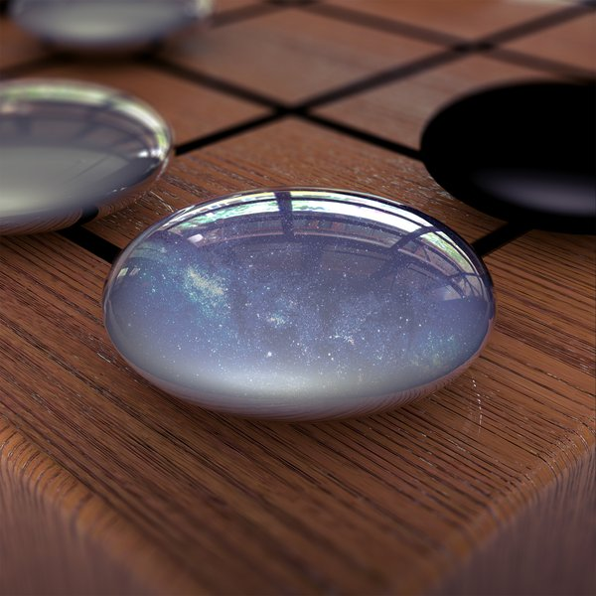
AlphaGo Zero
developed by DeepMind
Previous Version AlphaGo
used supervised learning
Won against Lee Sedol
Learns solely from self-play
No supervision of human data
Starting from completely random play
No hand-engineered features
No rollouts

Slide 4
The Algorithm - Overview
Self-play
Game
Boardstate
Neural Network
Monte-Carlo tree search
Policy
Policy improvement
Train network
Play game
Training data

Slide 5
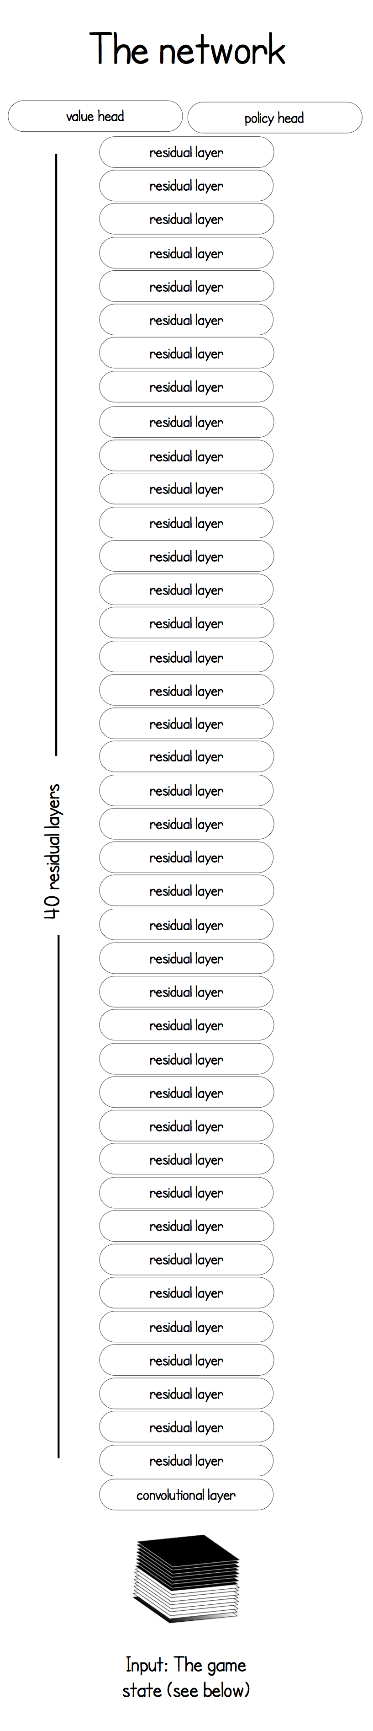
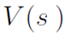
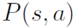
Neural Network
Only one neural Network
Previous versions used two networks
Network predicts:
Value of board state
Policy: Probabilities for valid actions
Input: Board State + History
Dimension: 19x19x17
8 feature planes for current players stones
8 feature planes for opponents stones
1 plane represents colour to play

Slide 6
Monte-Carlo tree search (MCTS)
MCTS is guided by neural network
Policy improvement
4 Phases:
Selection of Action
Expand and Evaluate
Backup
Play

Slide 7
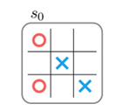
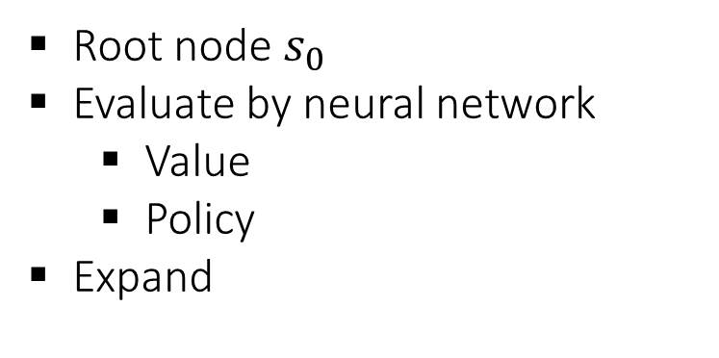
MCTS – Example: Tic Tac Toe
Root node $s_{0}$
Evaluate by neural network
Value
Policy
Expand

Slide 8
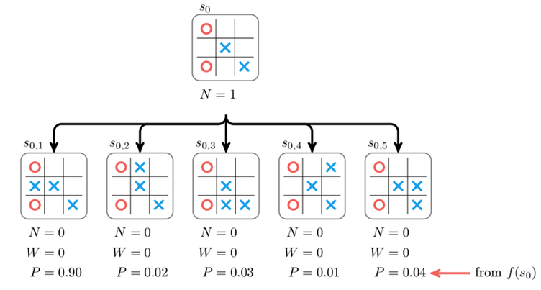
MCTS - Example
For every edge in the search tree we save:
Prior Probability P
Visit count N
Total action-value W
Mean action-value Q = W/N

Slide 9
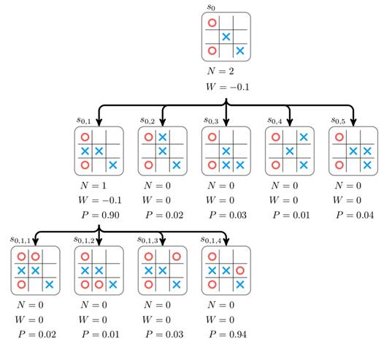
MCTS - Example

Slide 10
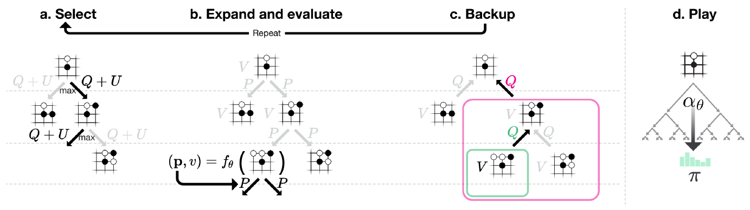
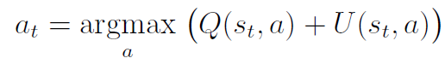
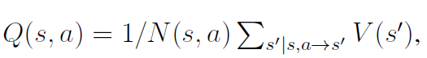
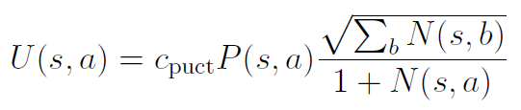
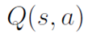
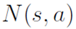
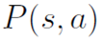
MCTS – Action Selection
Each simulation starts at the root and selects moves that maximise upper confidence bound Q + U
s … Board state a … Valid action in this state
This is repeated until a leaf node is encountered
Action value
Value count
Prior probability

Slide 11
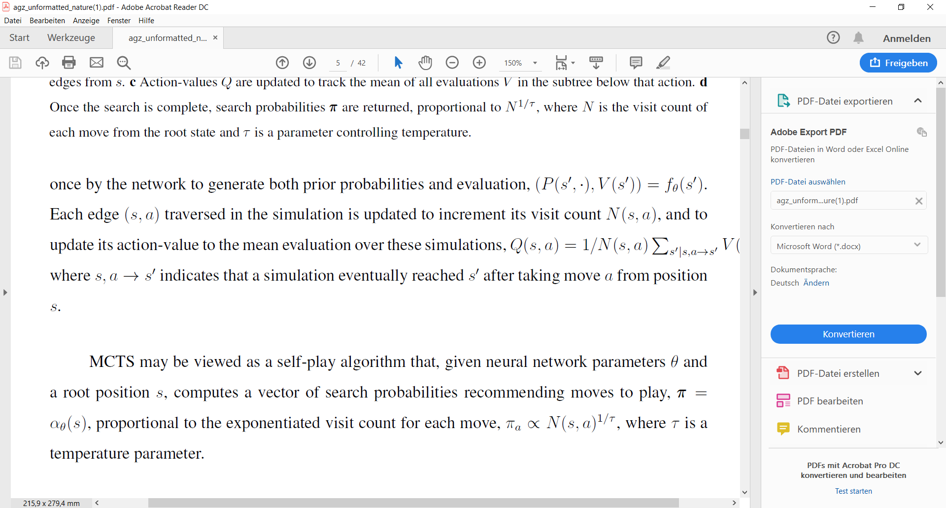
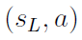
MCTS – Expand and Evaluate
The leaf node, with state ,is expanded and the corresponding board state is evaluated by the network
Each outgoing edge is initialised to:
No rollouts!

Slide 12
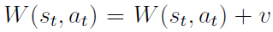
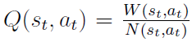
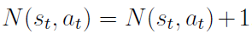
MCTS – Backup
Action values in the subtree below are updated:
Visit counts are incremented:

Slide 13
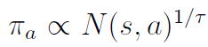
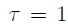
MCTS - Play
After the search a policy vector proportional to the visit count is computed:
Temperature for first 30 moves of each game and for the remainder of the game
The child node corresponding to the played action becomes the new root node
The subtree below that child is retained, the rest is discarded
Surrender if root value and best child value are low

Slide 14
MCTS - Summary
Multiple simulations are executed in parallel on separate threads

Slide 15
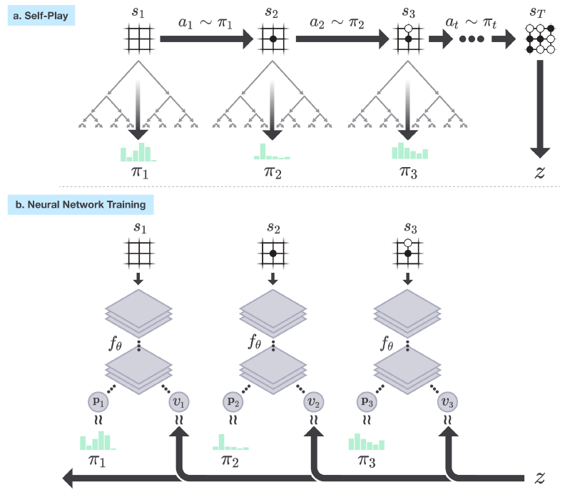
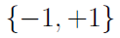
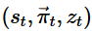
Training by Self-play
In each position MCTS is executed
Neural network guided MCTS improves policy
Save state of board and policy as training data
Game ends when
both players pass
search value drops under threshold
game exceeds maximum length
Add game outcome z = to training data

Slide 16
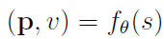
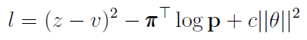
Self-play – Neural network training
Network is initialized with random weights
Train neural network on collected data with loss:
Minimize quadratic error between predicted winner and self-play winner
Cross entropy loss for policies
Weight decay
Mini-batch data is sampled randomly from all positions of the most recent 500 000 games of self-play
Stochastic gradient descent with momentum and learning rate annealing

Slide 17
Network Evaluation
Every 1000 training steps the network is evaluated
Networks play games against each other
Player 1: Current network, which is used to guide Self-play
Player 2: Network trained on data generated by self-play which was guided by current network and previous versions
MCTS is used in these games to improve policy
Infinitesimal temperature: select move with maximum visit count
If new network wins >55% of games -> used for self-play

Slide 18
Self-play pipeline
Three main components, all executed asynchronously in parallel:
Neural network is continually trained from recent self-play data
Networks are evaluated
currently best performing one is used to create self-play data
Training of Network
Self - play
Competition – Network Evaluation

Slide 19
Self-play: Numbers
Every 1000 training steps the network is evaluated
Network evaluation: 400 Games
Each iteration: 25000 games of self-play
with 1600 MCTS simulations to select each move

Slide 20
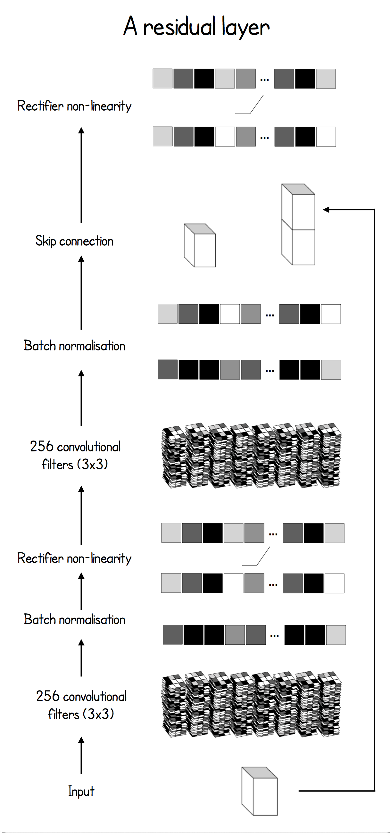
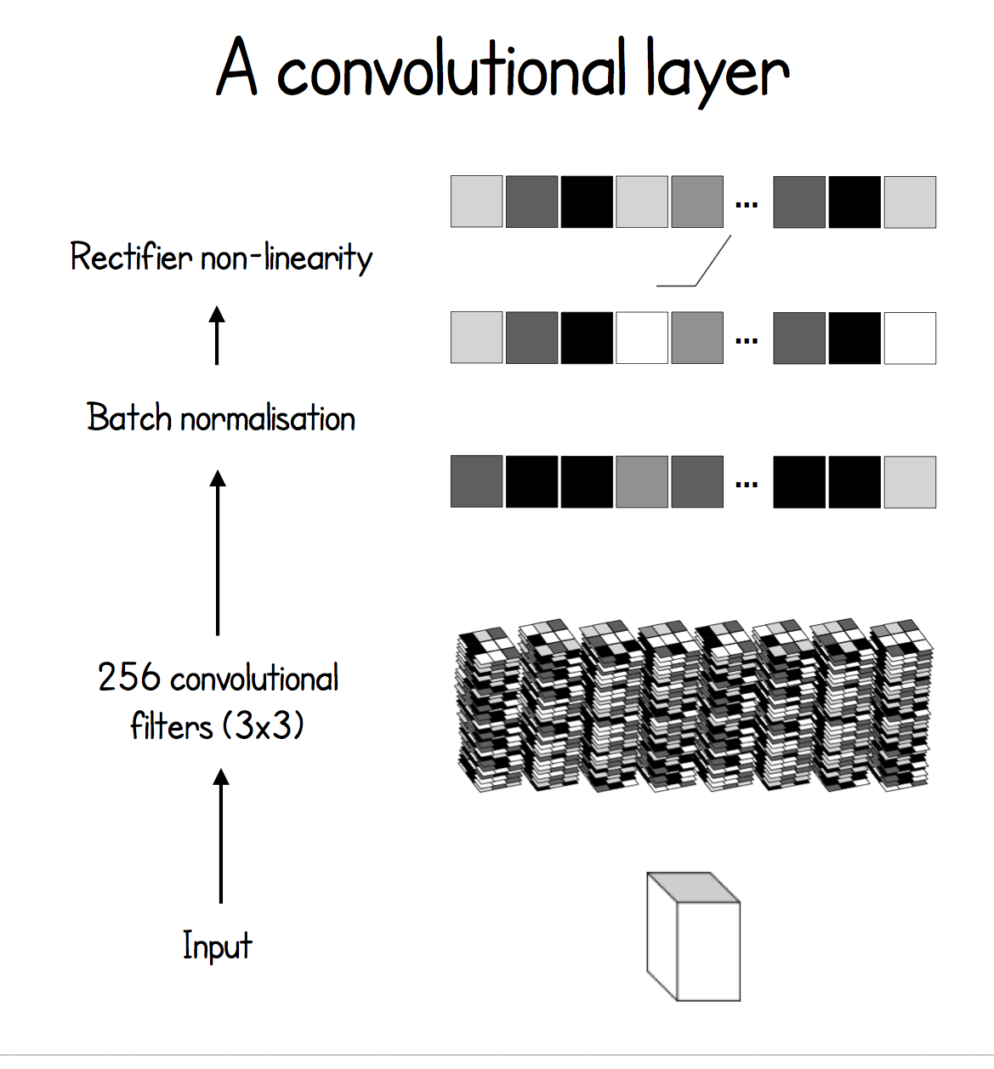
Neural Network Architecture
1 Convolutional layer:
256 filters, 3x3 kernel, stride 1
Batch normalization
ReLu
39 residual blocks:
256 filters, 3x3 kernel, stride 1
Batch normalization
ReLu
256 filters, 3x3 kernel, stride 1
Batch normalization
Skip connection (add Input)
ReLu

Slide 21
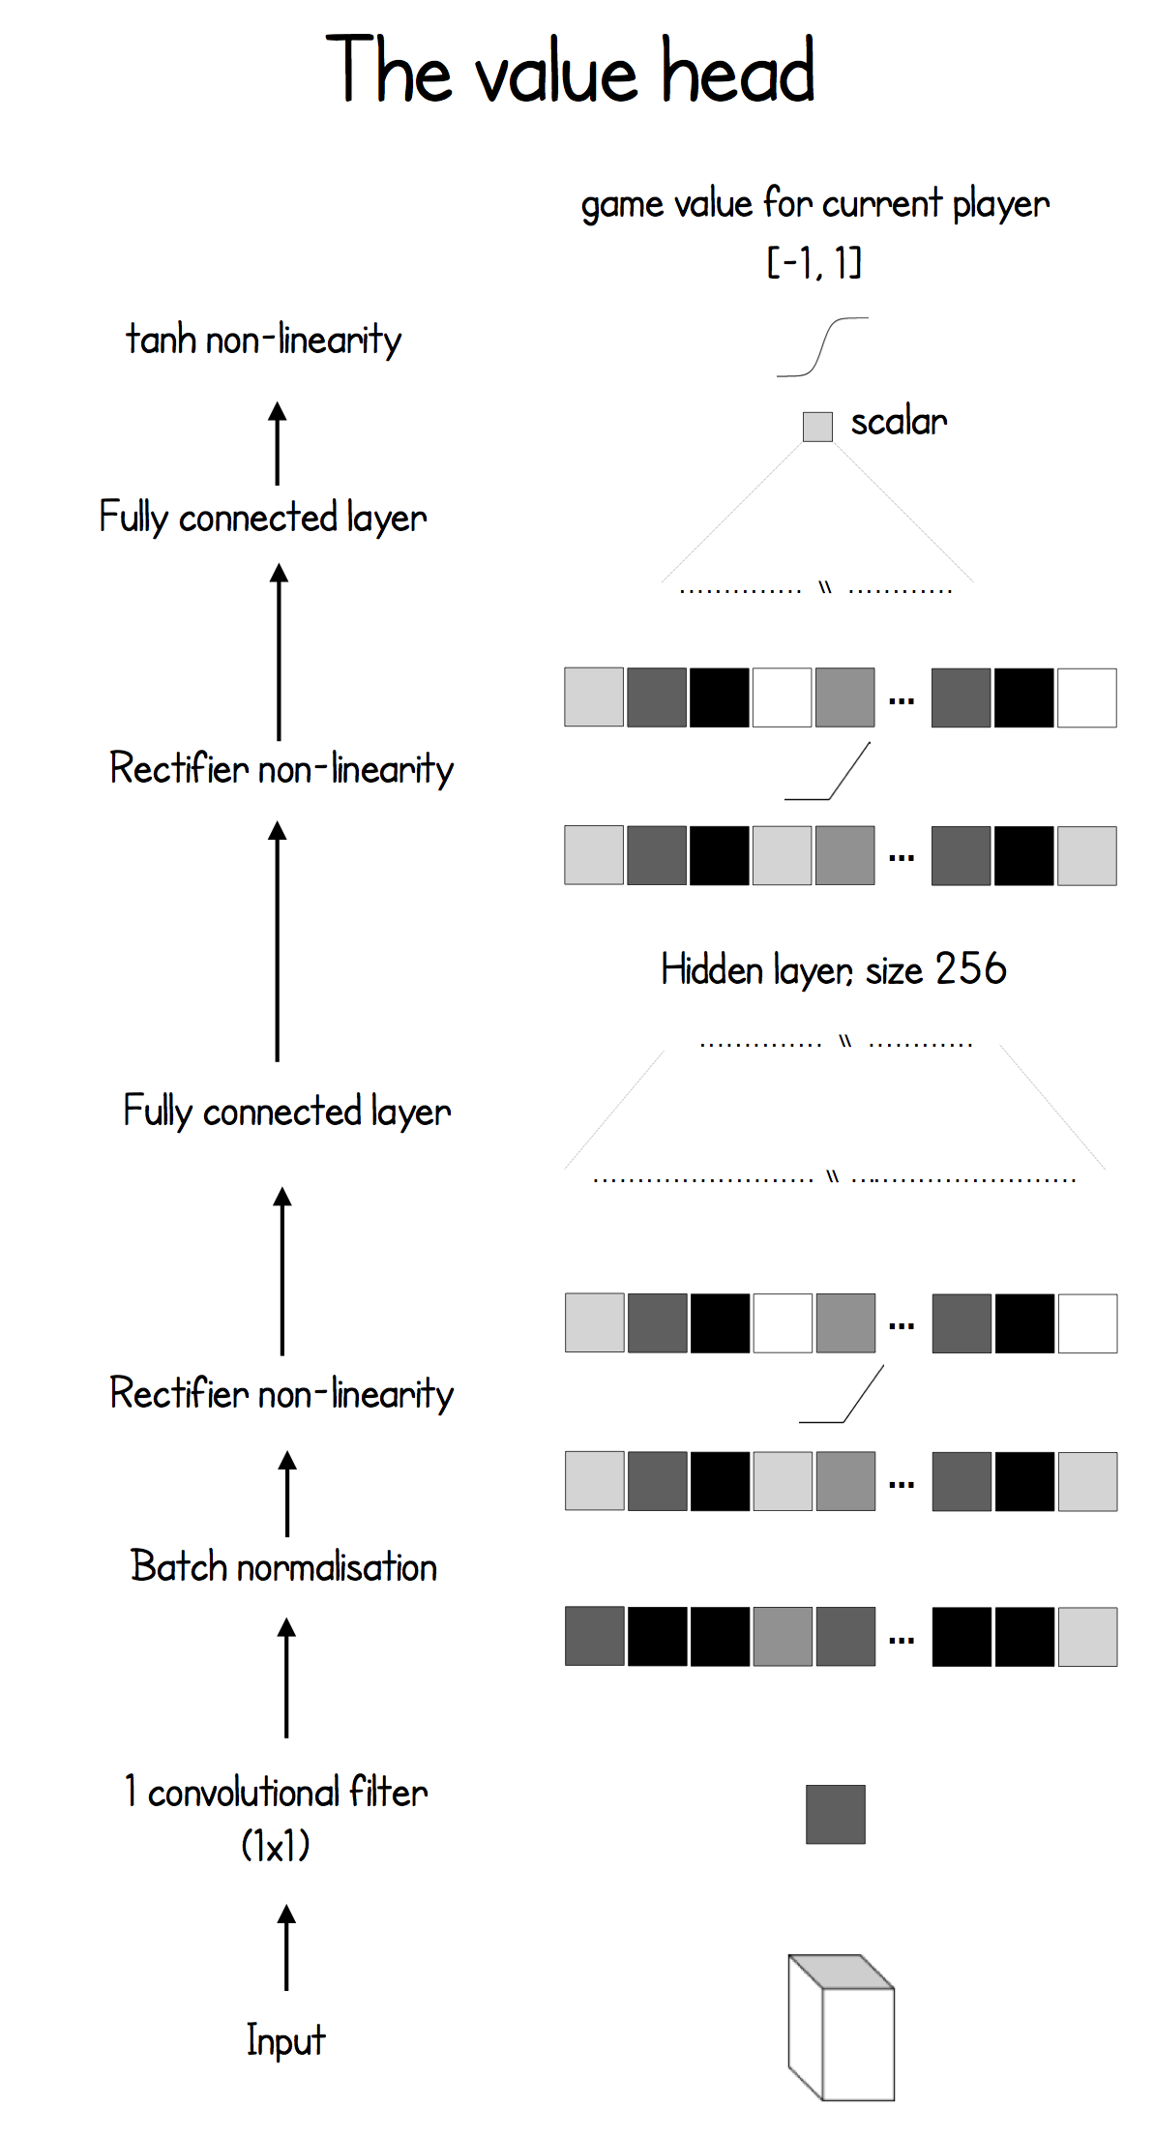
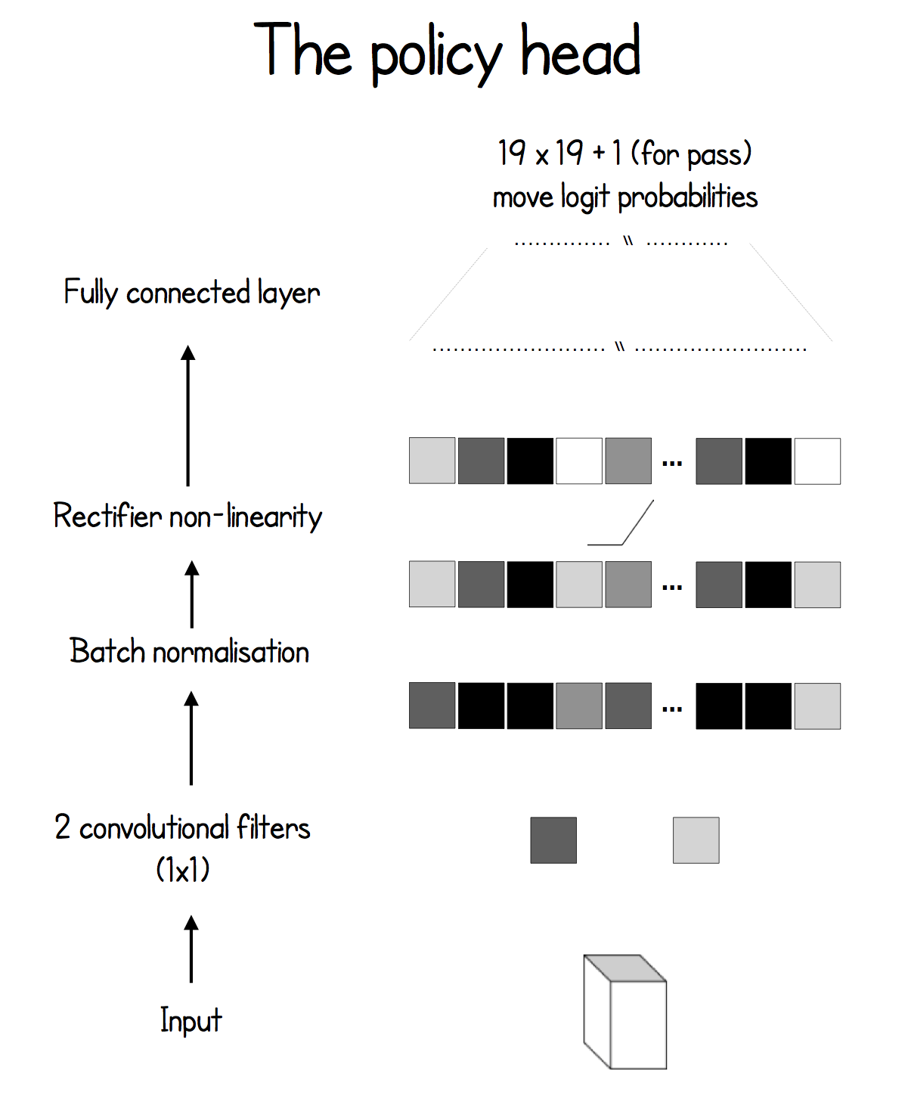
Neural Network Architecture
Two separate heads for policy and value
Trained 3 days with 19 ResNet layers
And 40 Days with 39 ResNet layers
using TensorFlow on 64 GPUs and 19 CPUs

Slide 22
Prior Knowledge necessary
Perfect knowledge of the rules of the game:
Scoring at end of game
Final states
Set of legal moves in each position
Symmetries of the game for data augmentation
Neural network architecture is matched to the grid-structure of the board
No human expert knowledge!

Slide 23
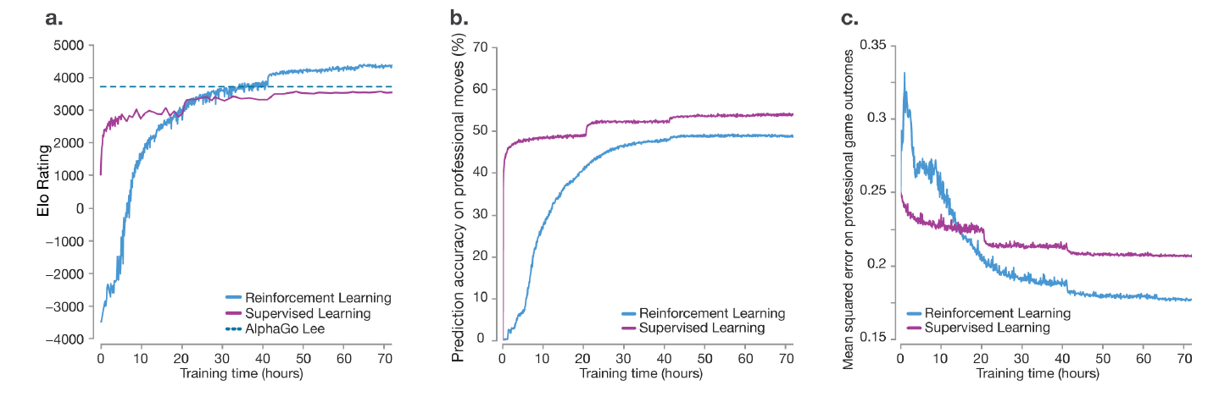
Empirical Analysis
AlphaGo Zero performs better than previous versions trained on human expert data
Is worse in predicting human moves and game outcomes
This suggests that AlphaGo Zero uses a different strategy than humans

Slide 24
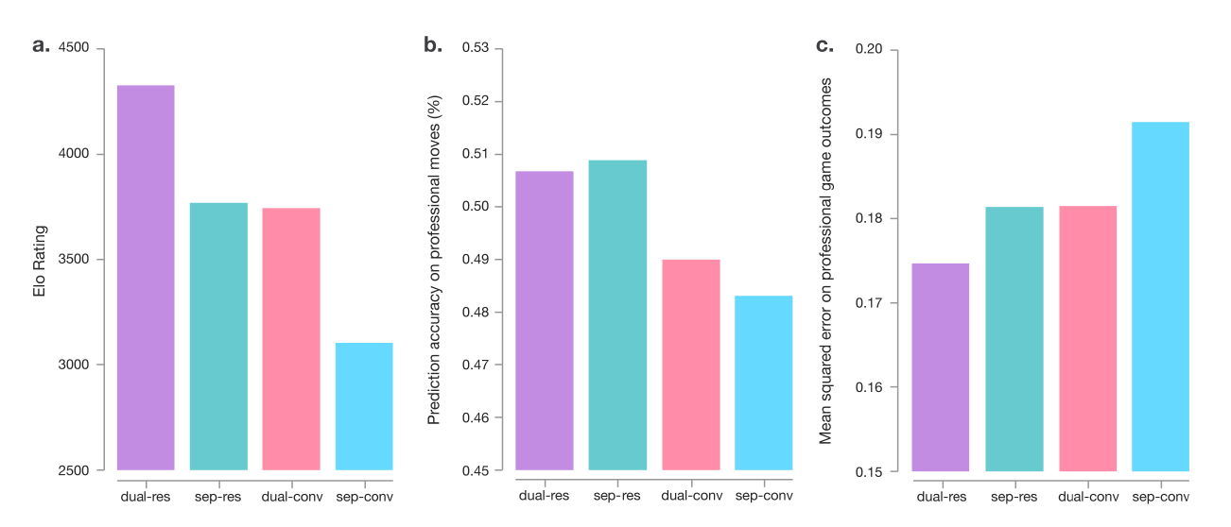
Technical improvements
Combining policy and value network improved performance by over 600 Elo
Using a residual network also improved the performance by about 600 Elo (Compared to CNN)

Slide 25
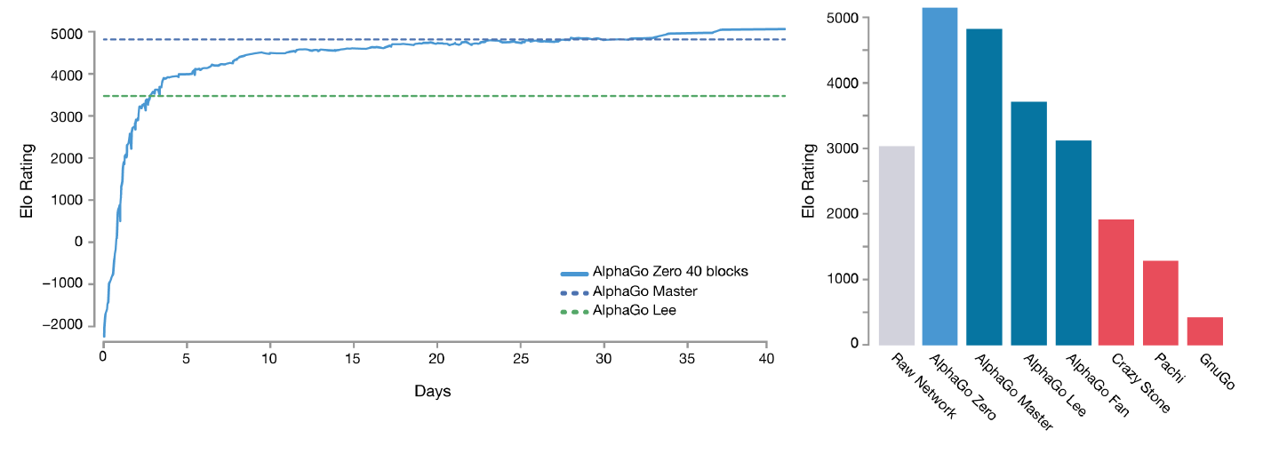
Comparison

Slide 26
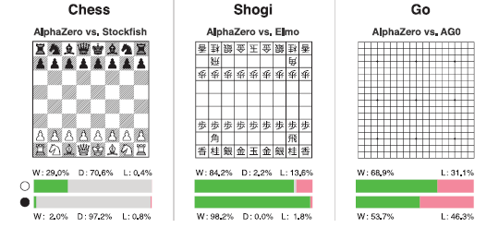
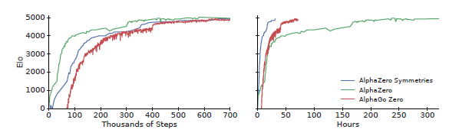
AlphaZero
Published on December 7th, 2018
More generic version: Chess, Shogi, Go
Changes to AlphaGo Zero:
Draws possible in Chess and Shogi
No symmetry augmentation
No network evaluation; Always latest network
Changed parameters
Same network architecture
Self-play 5000 TPUs, network 16 TPUs
700 000 training steps (4096 positions),
Training Time: Go 13 days, chess 9 hours

Slide 27
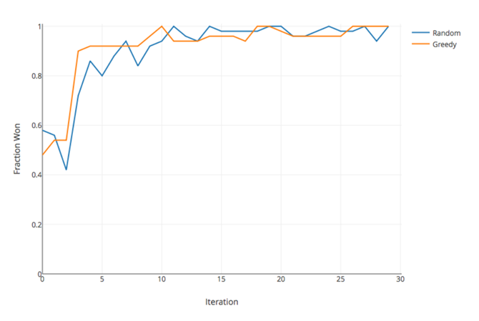
Implementation
Implemented by Surag Nair.
http://web.stanford.edu/~surag/
Go: Problem Training Time!
One GPU not enough
Other games:
Tic Tac Toe
Connect4
Othello

